Slide 1
Cryptography (2022 Fall) modes of operation, ECB, CBC, OFB, CTR
LiangFeng Zhang
zhanglf@shanghaitech.edu.cn
SIST, ShanghaiTech

Slide 2
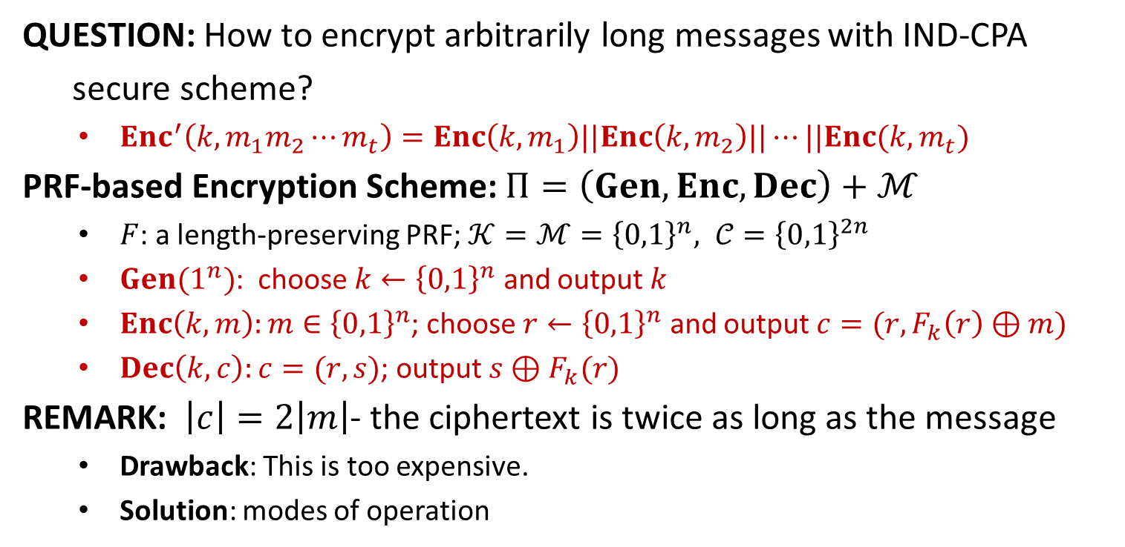
Encrypting More Efficiently
QUESTION: How to encrypt arbitrarily long messages with IND-CPA
secure scheme?
$Enc^{′}\left(k,m_{1}m_{2}⋯m_{t}\right)=Enc\left(k,m_{1}\right)||Enc\left(k,m_{2}\right)||⋯||Enc(k,m_{t})$
PRF-based Encryption Scheme: $Π=\left(Gen,Enc, Dec\right)+ℳ$
$F$: a length-preserving PRF; $𝒦=ℳ={\left\{0,1\right\}}^{n}, 𝒞={\left\{0,1\right\}}^{2n}$
$Gen(1^{n})$: choose $k←{\left\{0,1\right\}}^{n}$ and output $k$
$Enc\left(k,m\right):m∈{\left\{0,1\right\}}^{n}$; choose $r←{\left\{0,1\right\}}^{n}$ and output $c=(r,F_{k}\left(r\right)⊕m)$
$Dec\left(k,c\right):c=(r,s)$; output $s⊕F_{k}(r)$
REMARK: $\left|c\right|=2\left|m\right|$- the ciphertext is twice as long as the message
Drawback: This is too expensive.
Solution: modes of operation

Slide 3
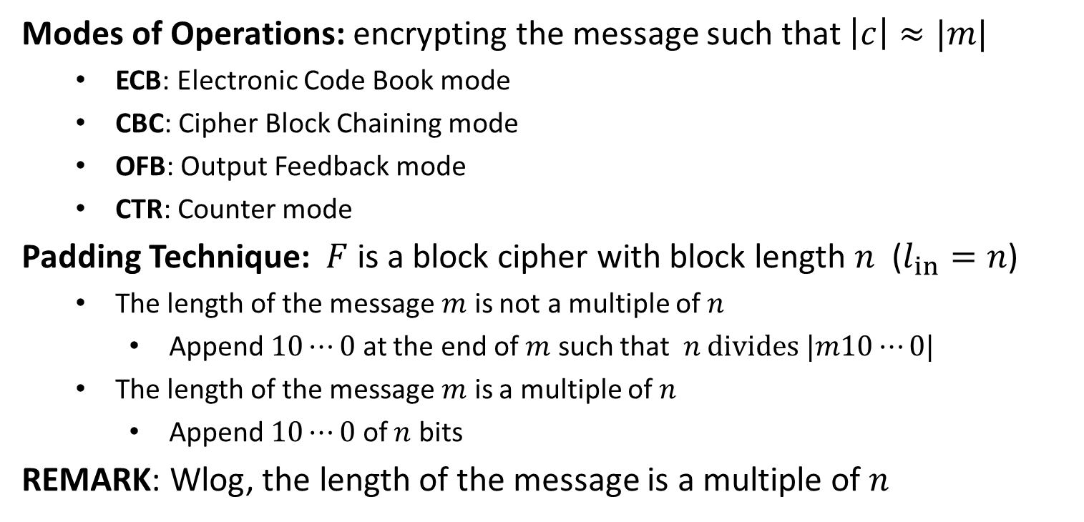
Modes of Operation
Modes of Operations: encrypting the message such that $\left|c\right|≈|m|$
ECB: Electronic Code Book mode
CBC: Cipher Block Chaining mode
OFB: Output Feedback mode
CTR: Counter mode
Padding Technique: $F$ is a block cipher with block length $n$ ($l_{in}=n$)
The length of the message $m$ is not a multiple of $n$
Append $10⋯0$ at the end of $m$ such that $n divides |m10⋯0|$
The length of the message $m$ is a multiple of $n$
Append $10⋯0$ of $n$ bits
REMARK: Wlog, the length of the message is a multiple of $n$

Slide 5

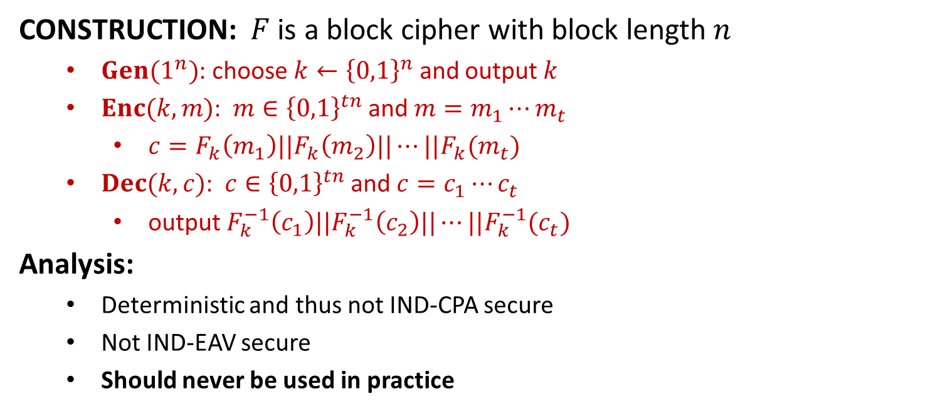







ECB
CONSTRUCTION: $F$ is a block cipher with block length $n$
$Gen(1^{n})$: choose $k←{\left\{0,1\right\}}^{n}$ and output $k$
$Enc(k,m)$: $m∈{\left\{0,1\right\}}^{tn}$ and $m=m_{1}⋯m_{t}$
$c=F_{k}\left(m_{1}\right)||F_{k}\left(m_{2}\right)||⋯||F_{k}(m_{t})$
$Dec(k,c)$: $c∈{\left\{0,1\right\}}^{tn}$ and $c=c_{1}⋯c_{t}$
output $F_{k}^{−1}\left(c_{1}\right)||F_{k}^{−1}\left(c_{2}\right)||⋯||F_{k}^{−1}(c_{t})$
Analysis:
Deterministic and thus not IND-CPA secure
Not IND-EAV secure
Should never be used in practice
$$m_{1}$$
$$m_{2}$$
$$m_{3}$$
$$F_{k}$$
$$F_{k}$$
$$F_{k}$$
$$c_{1}$$
$$c_{2}$$
$$c_{3}$$

Slide 6


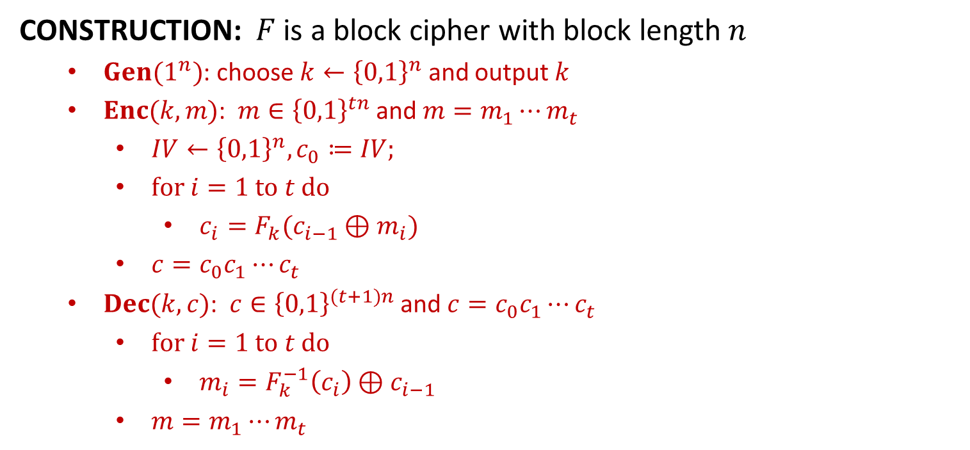






CBC
CONSTRUCTION: $F$ is a block cipher with block length $n$
$Gen(1^{n})$: choose $k←{\left\{0,1\right\}}^{n}$ and output $k$
$Enc(k,m)$: $m∈{\left\{0,1\right\}}^{tn}$ and $m=m_{1}⋯m_{t}$
$IV←{\left\{0,1\right\}}^{n}, c_{0}≔IV;$
$for i=1 to t do$
$c_{i}=F_{k}(c_{i−1}⊕m_{i})$
$c=c_{0}c_{1}⋯c_{t}$
$Dec(k,c)$: $c∈{\left\{0,1\right\}}^{(t+1)n}$ and $c=c_{0}c_{1}⋯c_{t}$
$for i=1 to t do$
$m_{i}=F_{k}^{−1}\left(c_{i}\right)⊕c_{i−1}$
$m=m_{1}⋯m_{t}$
$$m_{1}$$
$$m_{2}$$
$$m_{3}$$
$$IV$$
$$⨁$$
$$⨁$$
$$⨁$$
$$F_{k}$$
$$F_{k}$$
$$F_{k}$$
$$IV$$
$$c_{1}$$
$$c_{2}$$
$$c_{3}$$

Slide 7
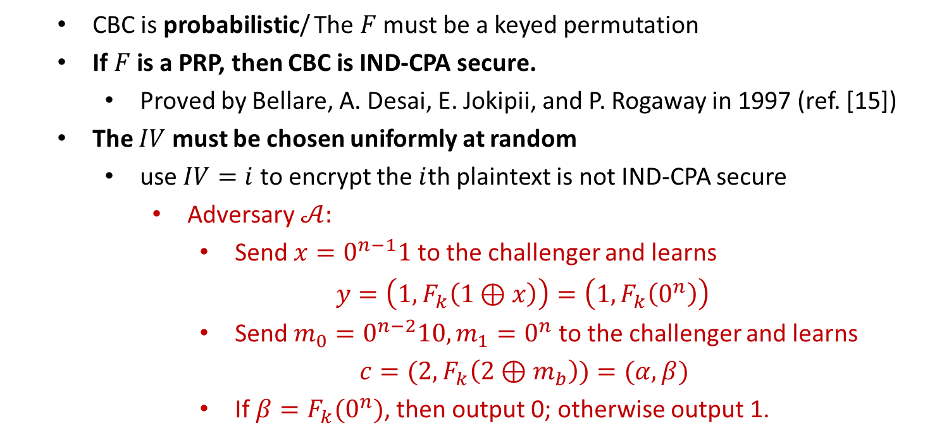
CBC
CBC is probabilistic/ The $F$ must be a keyed permutation
If $F$ is a PRP, then CBC is IND-CPA secure.
Proved by Bellare, A. Desai, E. Jokipii, and P. Rogaway in 1997 (ref. [15])
The $IV$ must be chosen uniformly at random
use $IV=i$ to encrypt the $i$th plaintext is not IND-CPA secure
Adversary $𝒜:$
Send $x=0^{n−1}1$ to the challenger and learns
$y=\left(1,F_{k}\left(1⊕x\right)\right)=\left(1,F_{k}\left(0^{n}\right)\right)$
Send $m_{0}=0^{n−2}10, m_{1}=0^{n}$ to the challenger and learns
$c=(2,F_{k}\left(2⊕m_{b}\right))=(α, β)$
If $β=F_{k}(0^{n})$, then output 0; otherwise output 1.

Slide 8
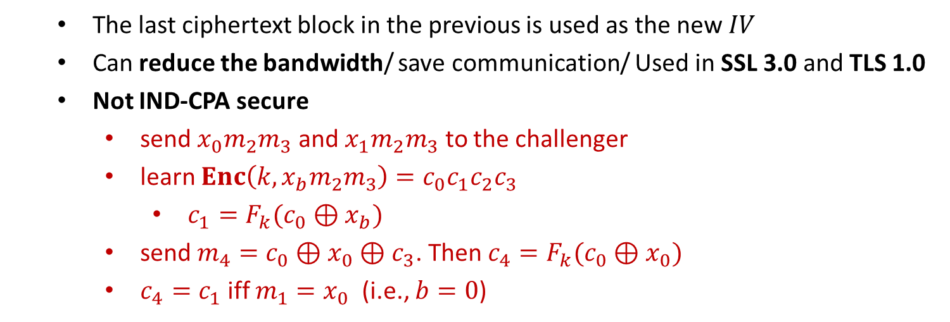
Chained CBC (Insecure)
The last ciphertext block in the previous is used as the new $IV$
Can reduce the bandwidth/ save communication/ Used in SSL 3.0 and TLS 1.0
Not IND-CPA secure
send $x_{0}m_{2}m_{3}$ and $x_{1}m_{2}m_{3}$ to the challenger
learn $Enc\left(k,x_{b}m_{2}m_{3}\right)=c_{0}c_{1}c_{2}c_{3}$
$c_{1}=F_{k}(c_{0}⊕x_{b})$
send $m_{4}=c_{0}⊕x_{0}⊕c_{3}$. Then $c_{4}=F_{k}(c_{0}⊕x_{0})$
$c_{4}=c_{1}$ iff $m_{1}=x_{0}$ (i.e., $b=0$)

Slide 9


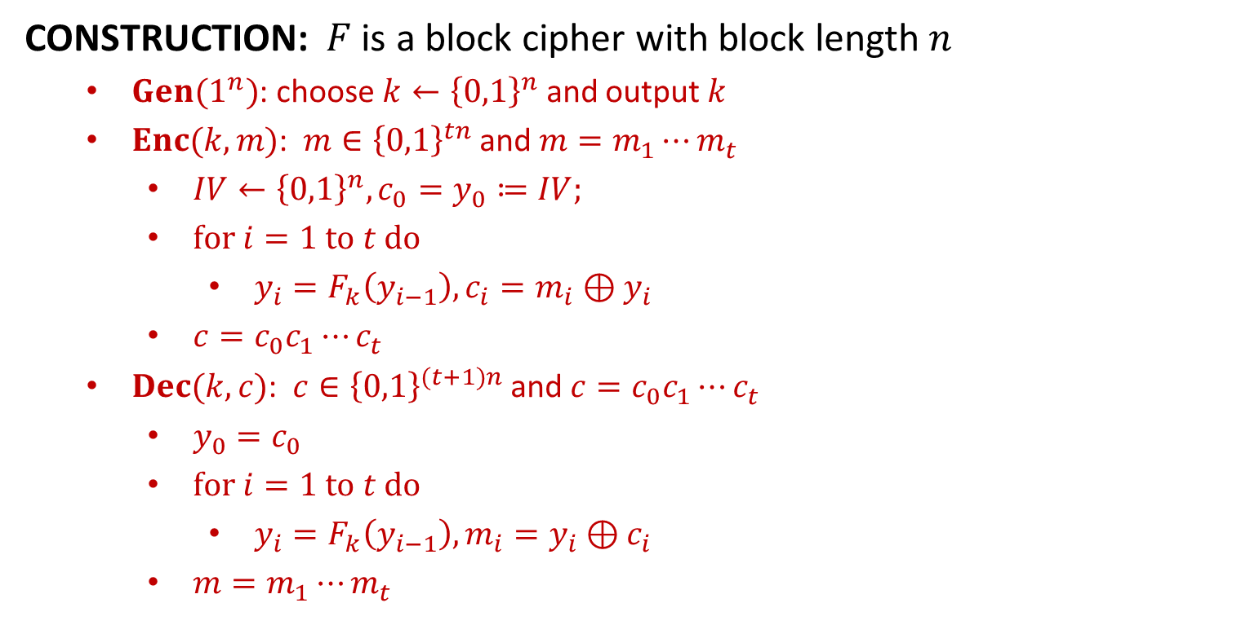











OFB
CONSTRUCTION: $F$ is a block cipher with block length $n$
$Gen(1^{n})$: choose $k←{\left\{0,1\right\}}^{n}$ and output $k$
$Enc(k,m)$: $m∈{\left\{0,1\right\}}^{tn}$ and $m=m_{1}⋯m_{t}$
$IV←{\left\{0,1\right\}}^{n}, {c_{0}=y}_{0}≔IV;$
$for i=1 to t do$
$y_{i}=F_{k}\left(y_{i−1}\right), c_{i}=m_{i}⊕y_{i}$
$c=c_{0}c_{1}⋯c_{t}$
$Dec(k,c)$: $c∈{\left\{0,1\right\}}^{(t+1)n}$ and $c=c_{0}c_{1}⋯c_{t}$
$y_{0}=c_{0}$
$for i=1 to t do$
$y_{i}=F_{k}\left(y_{i−1}\right), m_{i}=y_{i}⊕c_{i}$
$m=m_{1}⋯m_{t}$
$$IV$$
$$F_{k}$$
$$F_{k}$$
$$F_{k}$$
$$m_{1}$$
$$⨁$$
$$m_{2}$$
$$⨁$$
$$m_{3}$$
$$⨁$$
$$IV$$
$$c_{1}$$
$$c_{2}$$
$$c_{3}$$

Slide 10
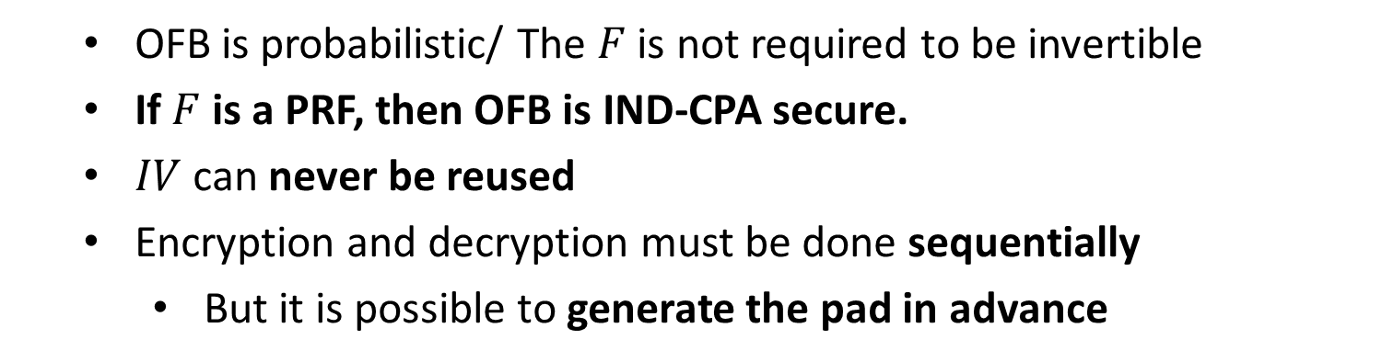
OFB
OFB is probabilistic/ The $F$ is not required to be invertible
If $F$ is a PRF, then OFB is IND-CPA secure.
$IV$ can never be reused
Encryption and decryption must be done sequentially
But it is possible to generate the pad in advance

Slide 11


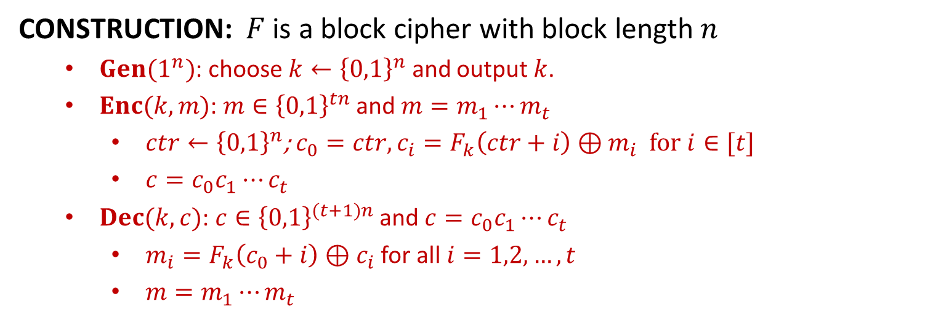



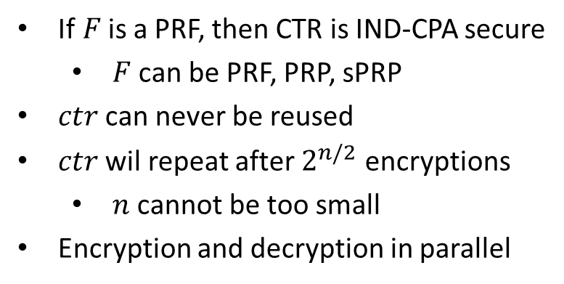











CTR
CONSTRUCTION: $F$ is a block cipher with block length $n$
$Gen(1^{n})$: choose $k←{\left\{0,1\right\}}^{n}$ and output $k$.
$Enc(k,m)$: $m∈{\left\{0,1\right\}}^{tn}$ and $m=m_{1}⋯m_{t}$
$ctr←{\left\{0,1\right\}}^{n}$; $c_{0}=ctr, c_{i}=F_{k}\left(ctr+i\right)⊕m_{i}$ for $i∈[t]$
$c=c_{0}c_{1}⋯c_{t}$
$Dec(k,c)$: $c∈{\left\{0,1\right\}}^{(t+1)n}$ and $c=c_{0}c_{1}⋯c_{t}$
$m_{i}=F_{k}\left(c_{0}+i\right)⊕c_{i}$ for all $i=1,2,…,t$
$m=m_{1}⋯m_{t}$
$$ctr$$
$$ctr+1$$
$$ctr+2$$
$$ctr+3$$
If$F$is a PRF, then CTR is IND-CPA secure
$F$ can be PRF, PRP, sPRP
$ctr$ can never be reused
$ctr$ wil repeat after $2^{n/2}$ encryptions
$n$ cannot be too small
Encryption and decryption in parallel
$$F_{k}$$
$$F_{k}$$
$$F_{k}$$
$$m_{1}$$
$$⨁$$
$$m_{2}$$
$$⨁$$
$$m_{3}$$
$$⨁$$
$$ctr$$
$$c_{1}$$
$$c_{2}$$
$$c_{3}$$

